Slide 1
06
Getting Started with Google Colab
Python Programming for Linguists
Ingo Kleiber, 2021
Note: This video can be watched independently of all other videos in this workshop!

Slide 2
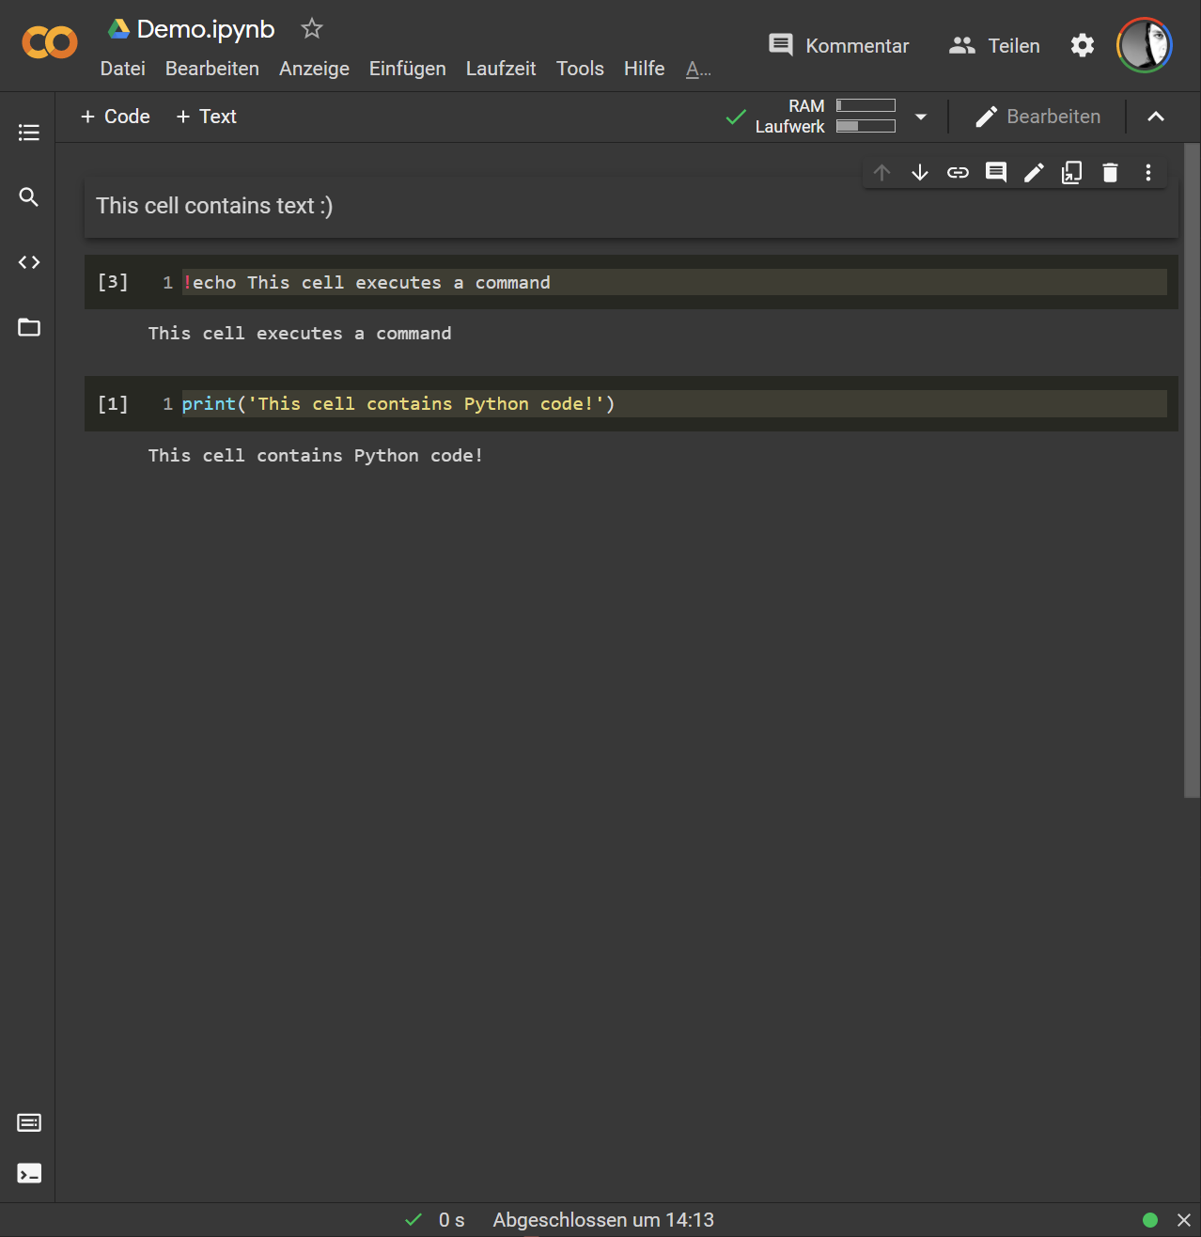
Google Colaboratory / “Colab”
Google Colab = executable documents containing both code and documentation
Interactive coding environment that allows us to write, run, and share code in the browser
Cells can contain code (e.g., Python) and other content
Technically, these are basically Jupyter Notebooks in Google Drive

